Slide 1
ADVANCED SKIN DISEASES DETECTION.
Team 5

Slide 2
ABOUT THE PROJECT

Slide 3
INTRODUCTION
The Advanced Skin Diseases System is a web application developed using Python Django, designed to assist users in identifying common skin diseases through Image Processing and Machine Learning.
The application not only provides the names of the skin diseases and information on its symptoms, but also incorporates Computer Vision (CV) techniques to process uploaded skin images.

Slide 4
Using defect detection algorithms, the system analyzes areas of concern such as rashes, pimples, or lesions. These defects are analyzed, and the system provides an accurate assessment of the condition.
Moreover, the system utilizes Machine Learning models trained on datasets of skin images to generate predictions and estimate the accuracy of its diagnosis, helping users make more informed decisions about their skin and skincare routines.

Slide 5
PROJECT OVERVIEW AS CUSTOMER FEATURE
Create: A new user account to access the application.
Login: With your username and password.
Input page: User can upload their photos.
View page: User can view their uploaded images

Slide 6
MILESTONE
The system allows users to register, log in, and verify email addresses, with security measures to protect user data.
We learn about the OpenCV and using this we understand how to process the images, in this we convert real image into gray scale, inverted, blur or more.
1
2

Slide 7
MILESTONE
We implemented the UI to read an image from user, process that image with OpenCV to calculate the dimensions of the skin disease area in UI back
We prepared the dataset for training the model to generate approximate accurate values.
3
4

Slide 8

HOME PAGE AND LOGIN PAGE SCREENSHOTS

Slide 9
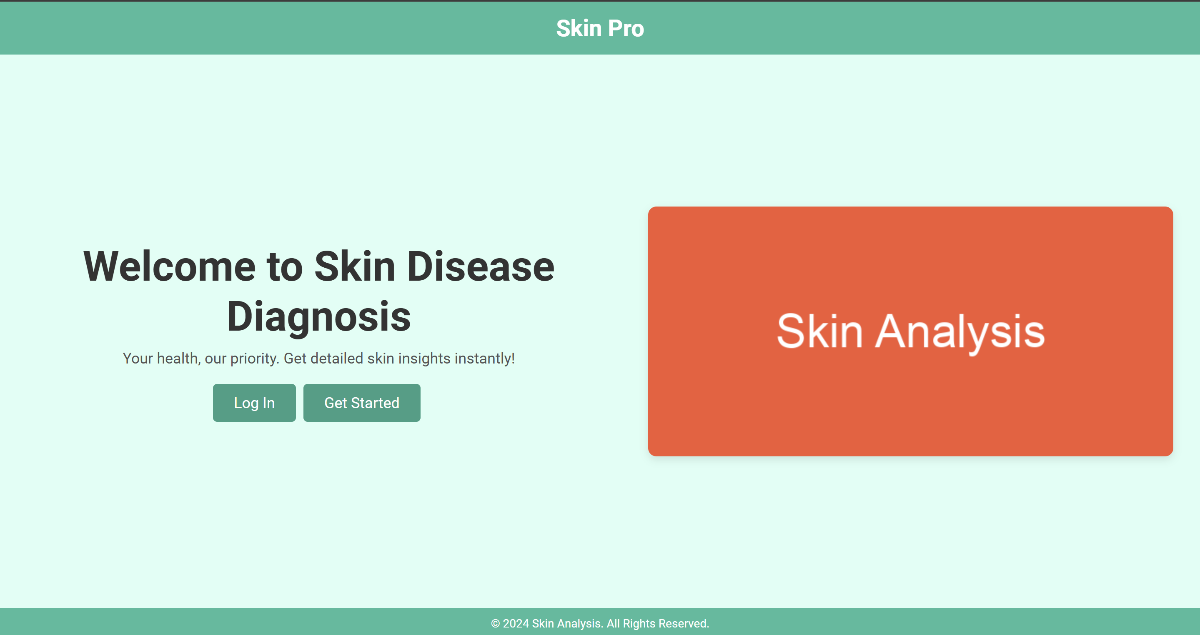
HOME PAGE:
Redirects to Login Page
Redirects to Sign Up page
A simple carousel

Slide 10
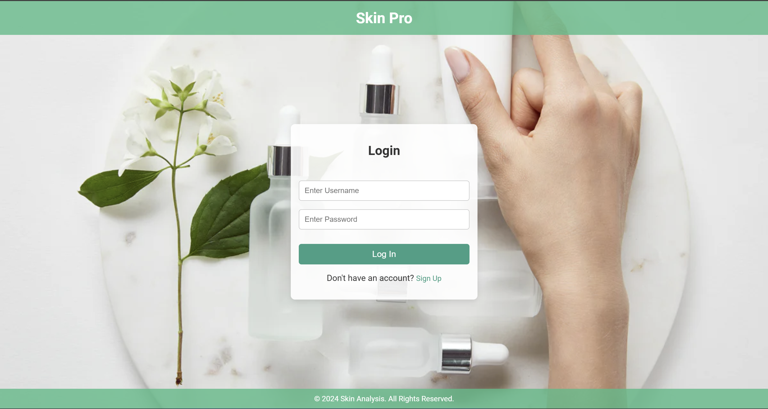
LOGIN PAGE:
User has to enter their existing and valid Username and Password

Slide 11
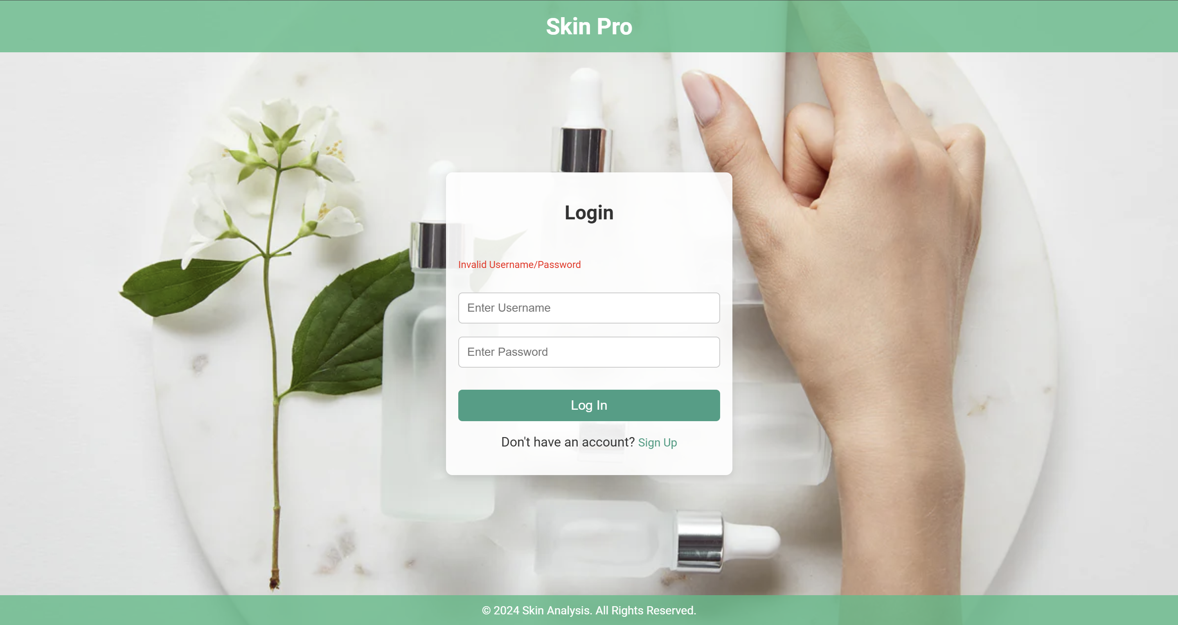
LOGIN PAGE:
If the username and password is correct then it redirects to the profile page, else “Invalid username/password” is displayed

Slide 12
LOGIN PAGE:
This link redirects to the Sign Up page

Slide 13

REGISTRATION PAGE AND PROFILE PAGE SCREENSHOTS

Slide 14
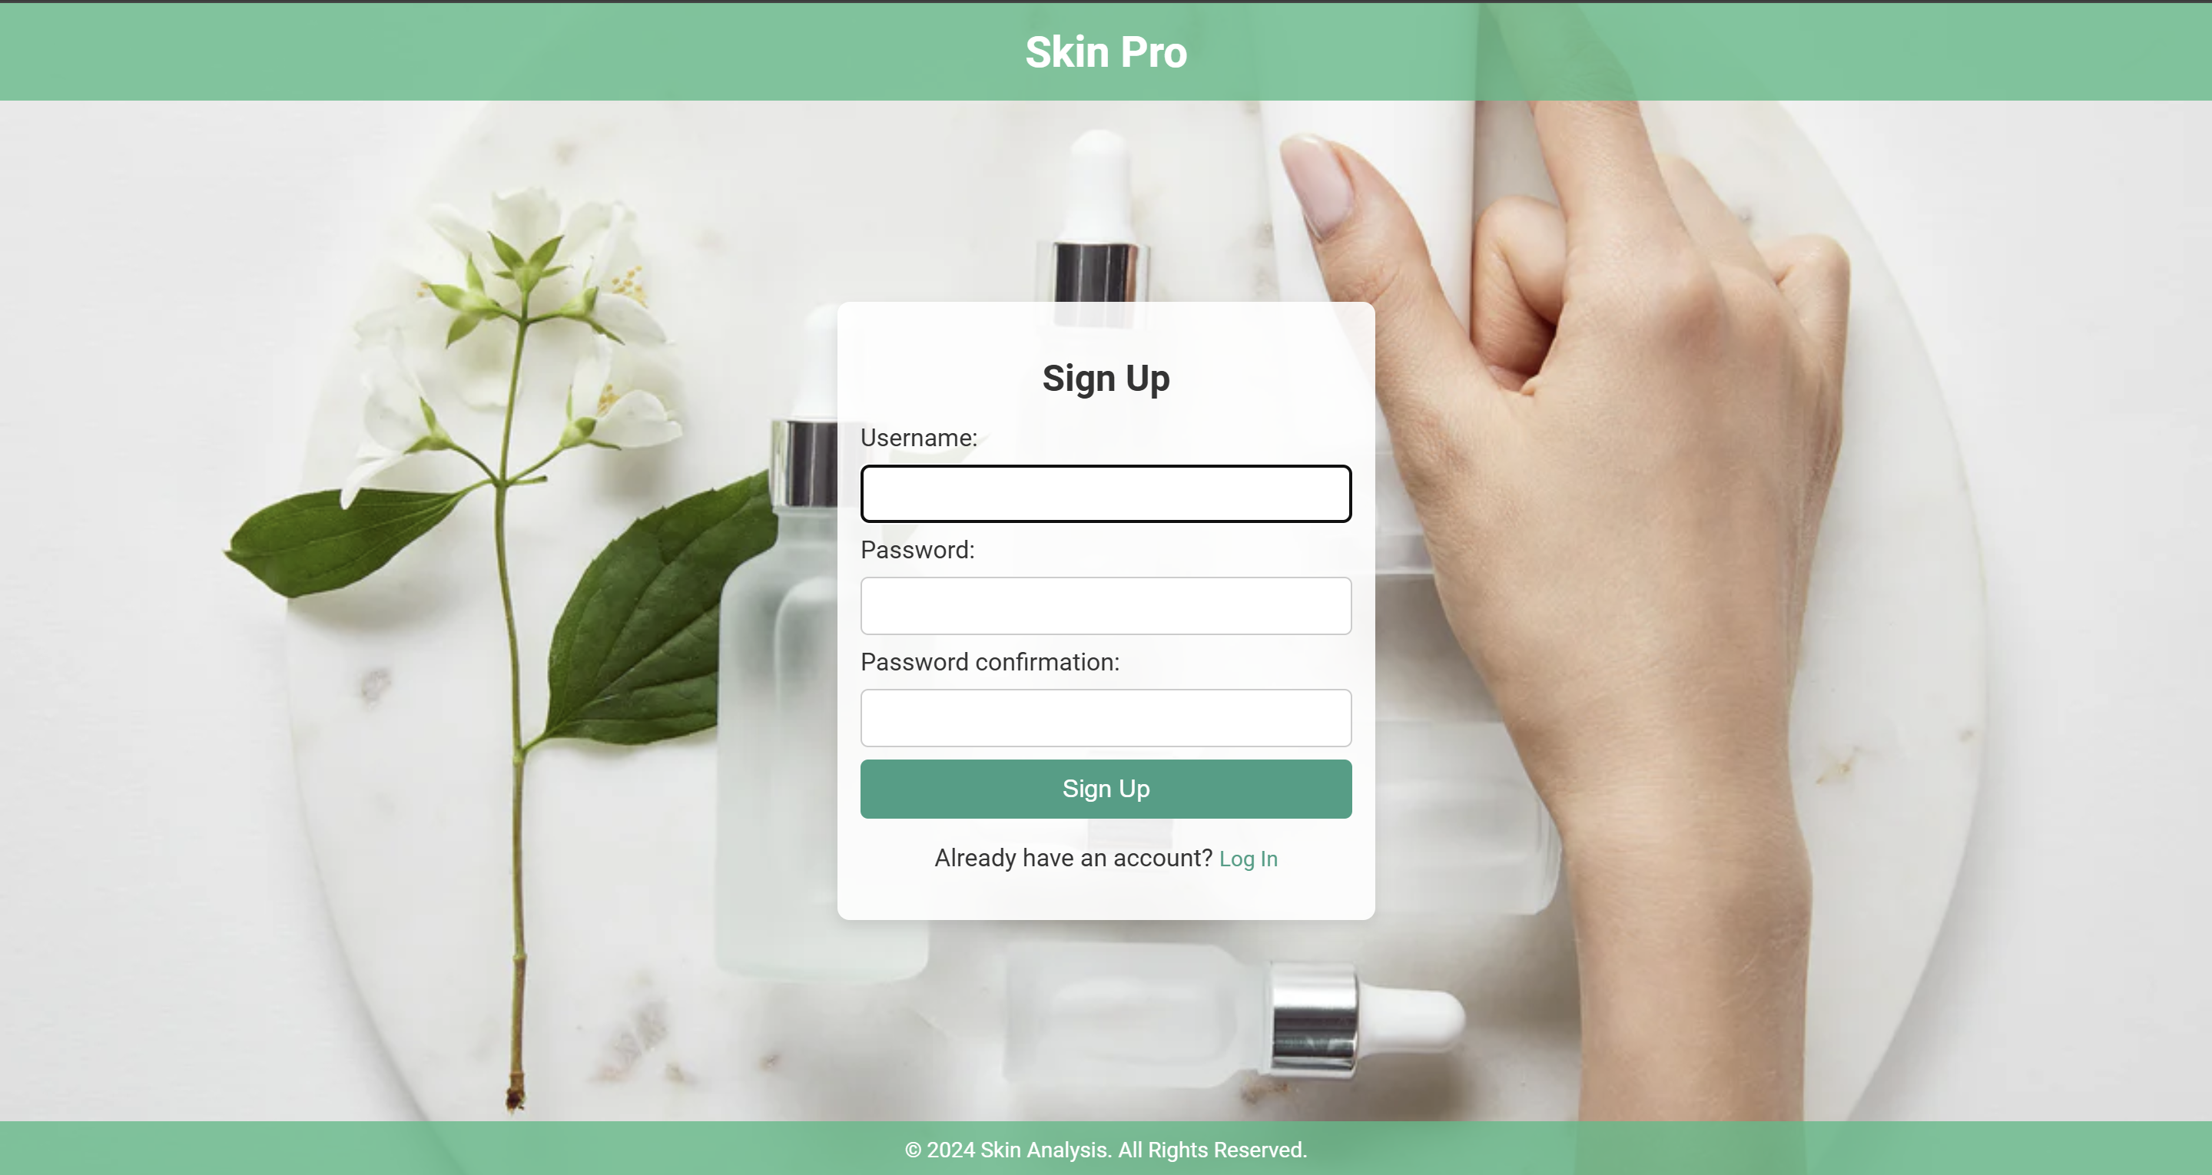
SIGNUP PAGE:
Enter a new Username which is not pre-existent
Enter unique Password
Confirm with same Password
The pass must contain at least 8 characters, and it should not be a common password

Slide 15
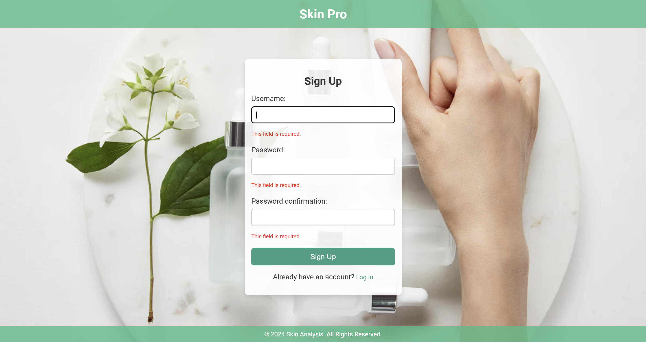
SIGNUP PAGE:
“This field is required.” is displayed whenever a field is missing user input.

Slide 16
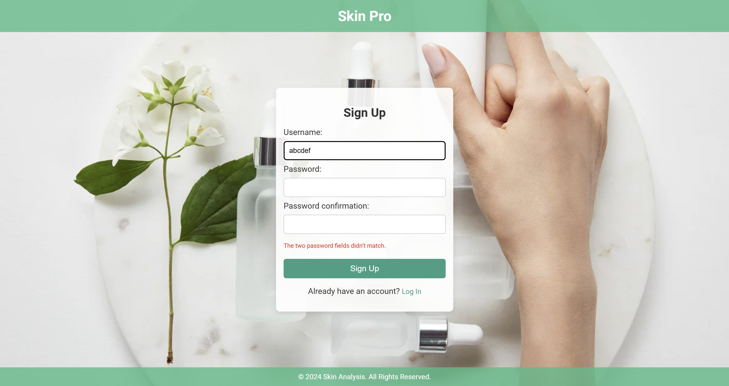
SIGNUP PAGE:
“The two password field didn’t match.” is displayed whenever the password confirmation is mismatched with the entered password.

Slide 17

SIGNUP PAGE:
This message is displayed whenever the entered password is either not at least 8 characters long, or is too common to be a secure password.

Slide 18
SIGNUP PAGE:
This link redirects to the Login page.

Slide 19
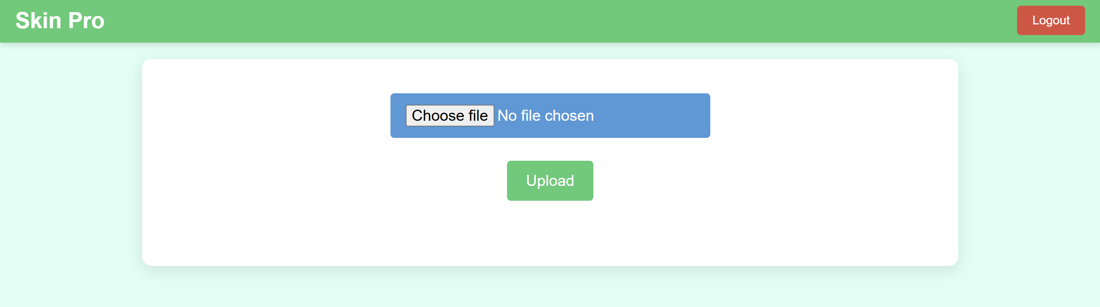
PROFILE PAGE:
A simple User Interface (UI) for a simple and seamless User Experience (UX)

Slide 20
PROFILE PAGE:
Clicking on the “Logout” button ends the session for the user and redirects to the Login page
Choose an image through the file browser
Click upload button after the file is chosen

Slide 21
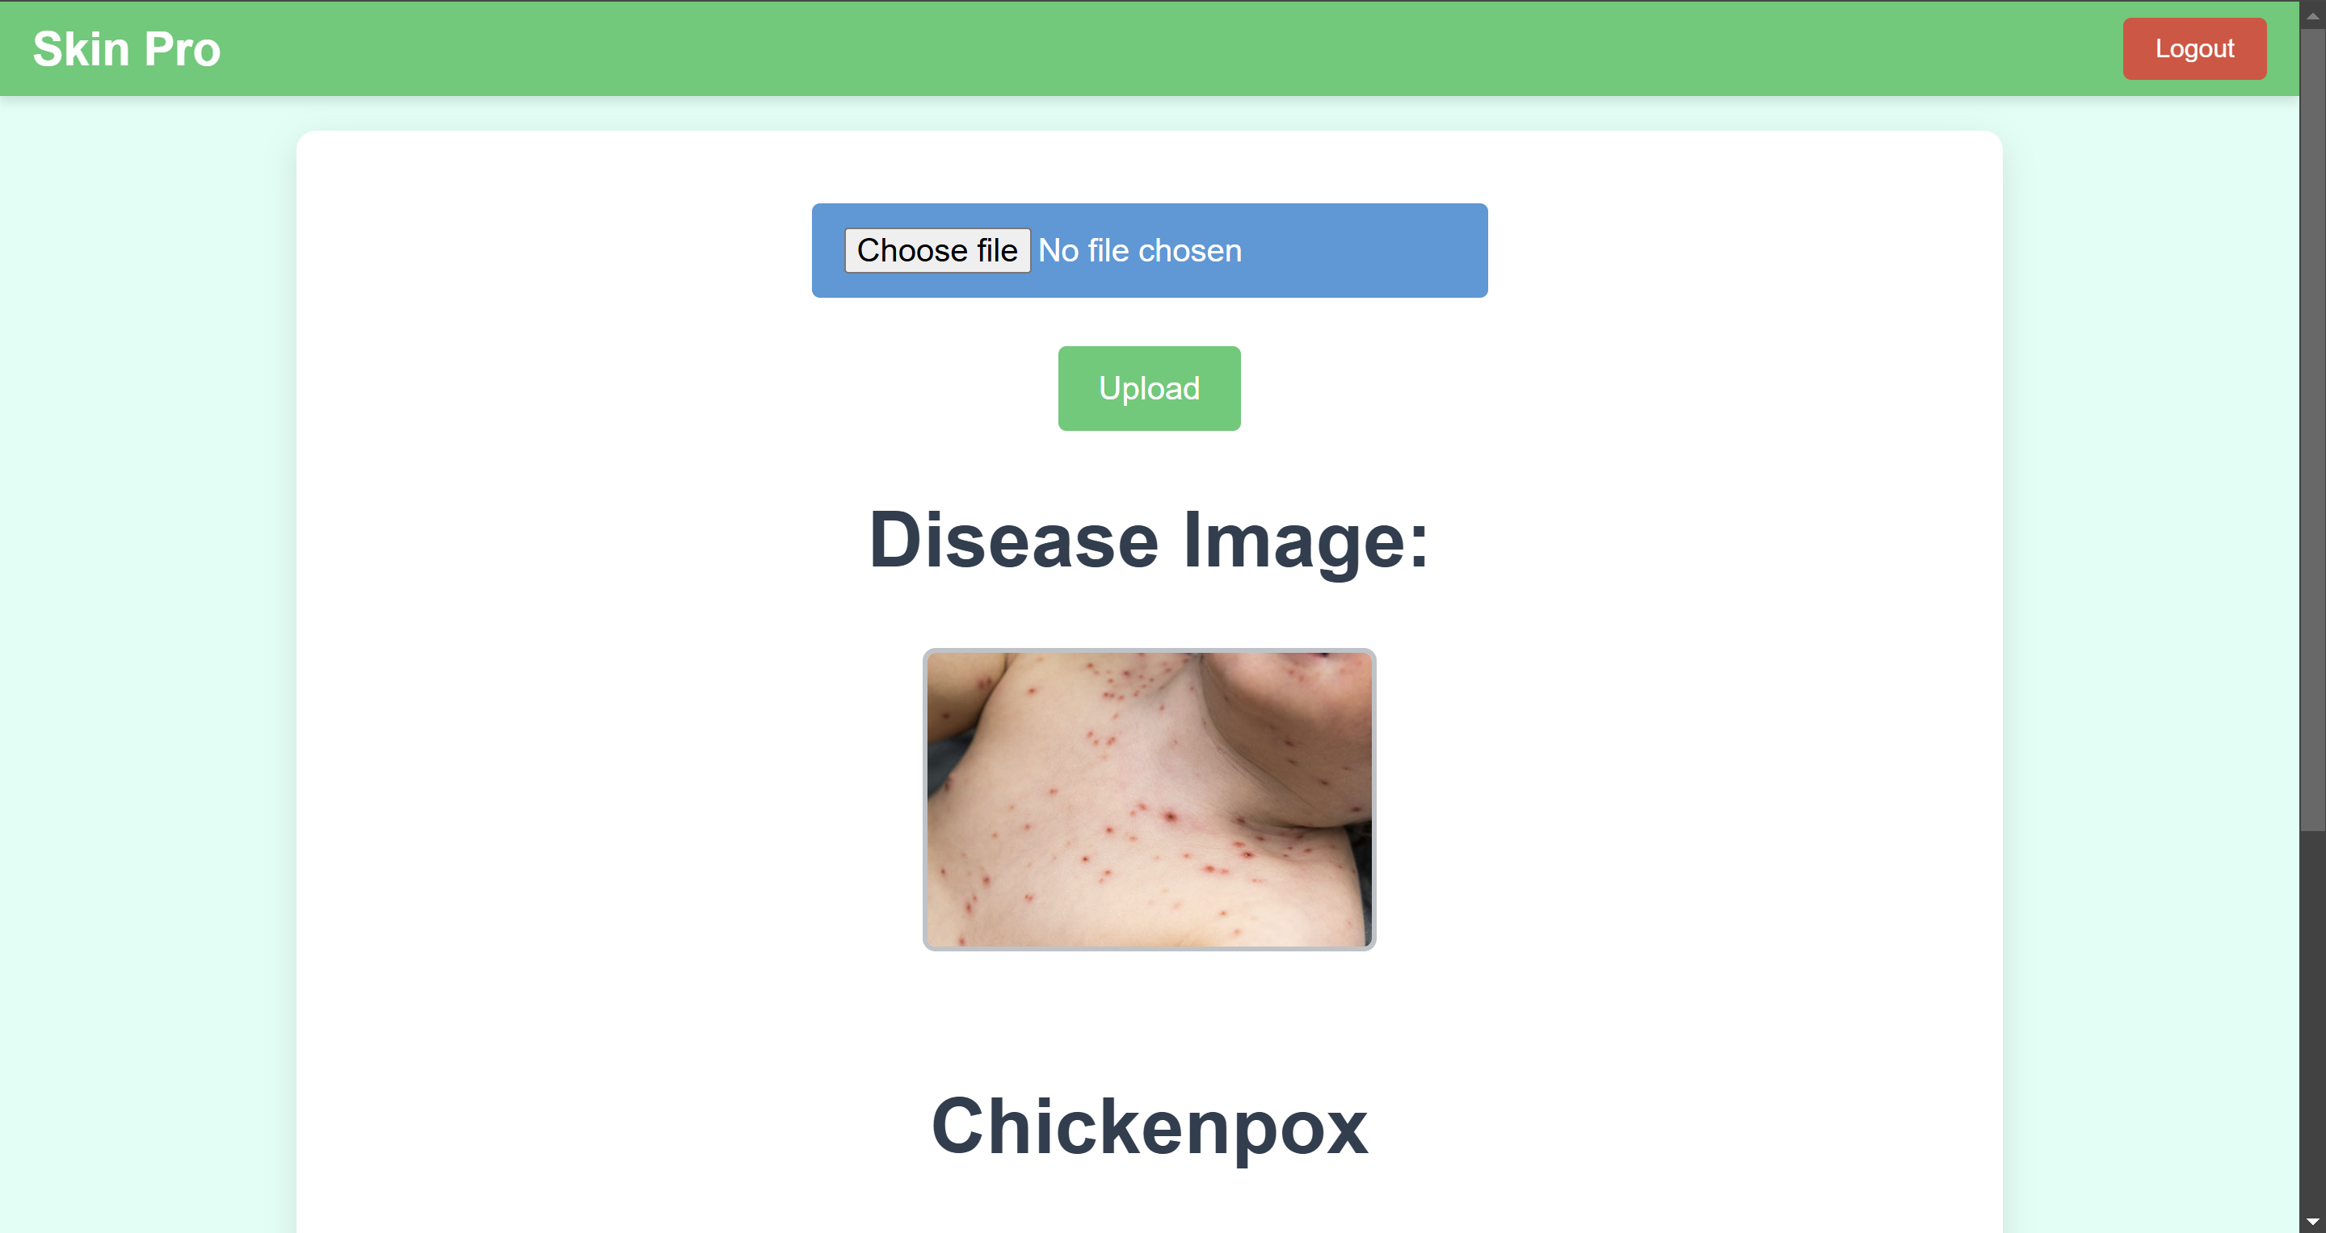
PROFILE PAGE AFTER UPLOD THE IMAGE:
Disease image that was submitted by the user
Predicted disease name

Slide 22
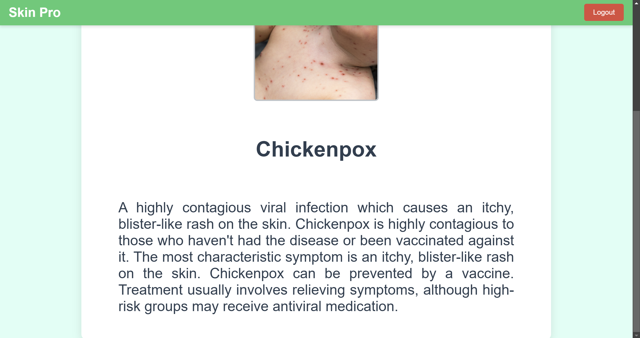
PROFILE PAGE AFTER UPLOD THE IMAGE:
Predicted disease name
Description, symptoms, general methods of prevention/cure, etc. about the predicted disease

Slide 23
MODEL TRAINING PROCESS
Data Preparation:
Images form various different categories (for eg. Cellulitis, Chickenpox, etc.) are resized to 224x224 pixels, normalized and standardized for feature extraction.
Model Training:
From the extracted features, many models like Vision Transformer (ViT), ResNet18, DenseNet, Support Vector Machine (SVM), Logistic Regression, Decision Tree, etc.
ViT (with pre-trained parameters from ‘timm’ library) was chosen since it gave the best testing accuracy without overfitting.
1
2

Slide 24
MODEL TRAINING PROCESS
Evaluation:
Achieved 95.30% accuracy on test data set.
Integration:
The trained model was exported into a “.pth” file.
This model file is integrated into the Profile page, where images are processed and passed to the loaded model for prediction.
3
4

Slide 25
ABOUT MODEL
At first, we used various models from Scikit-learn, such as SVM (with various “kernels”), Logistic Regression, Decision Trees, Naïve Bayes, K-Nearest Neighbor, etc.
‘joblib’ library was used to generate/dump and load the model that we made.
But at its best, this gave us a very mediocre result in the form of testing accuracy of 74%.
We knew that things needed to change.

Slide 26
ABOUT MODEL
So then, we used the combination of Visual Transformers (ViT) from PyTorch and various models from Scikit-learn.
PyTorch has the option of using GPU (using CUDA toolkit) as a device, which allowed the model to be trained at an accelerated rate.
This produced a very good testing accuracy of 97.86%.
But it turns out that the model was Overfitting and generating noisy and incorrect output.

Slide 27
ABOUT MODEL
So, we deprecated the use of Scikit-learn and joblib, and proceeded with ViT with pre-trained parameters from the ‘timm’ library.
After our model was trained, within just 5 ‘epochs’ it gave us a testing accuracy of 95.30%.
After trying and testing all these models (with different parameters and libraries), we selected ViT (with pre-trained parameters from ‘timm’ library), since it gave us the best accuracy without either underfitting or overfitting.

Slide 28
CONCLUSION
The Advanced Skin Diseases System is an AI based image analyzer platform accessible from the web. It is a powerful tool that combines computer vision and machine learning to aid in identifying skin conditions with precision. By processing skin images to detect defects and providing accurate predictions, the system empowers users with valuable insights into their skin health.

Slide 29

CONCLUSION
This innovative solution bridges the gap between technology and healthcare, offering users a convenient and accurate way to address skin-related concerns.
This project provides an accessible web-technology based solution for diagnosis.

Slide 30


TEAM MEMBERS
Aditya Saklani
Ankita Pagare
Saurabh Kumar
Prabhakar Jha
Ankush Prajapati
Notes:
https://www.freepik.com/free-photo/medium-shot-doctors-work_23490790.htm

Slide 31
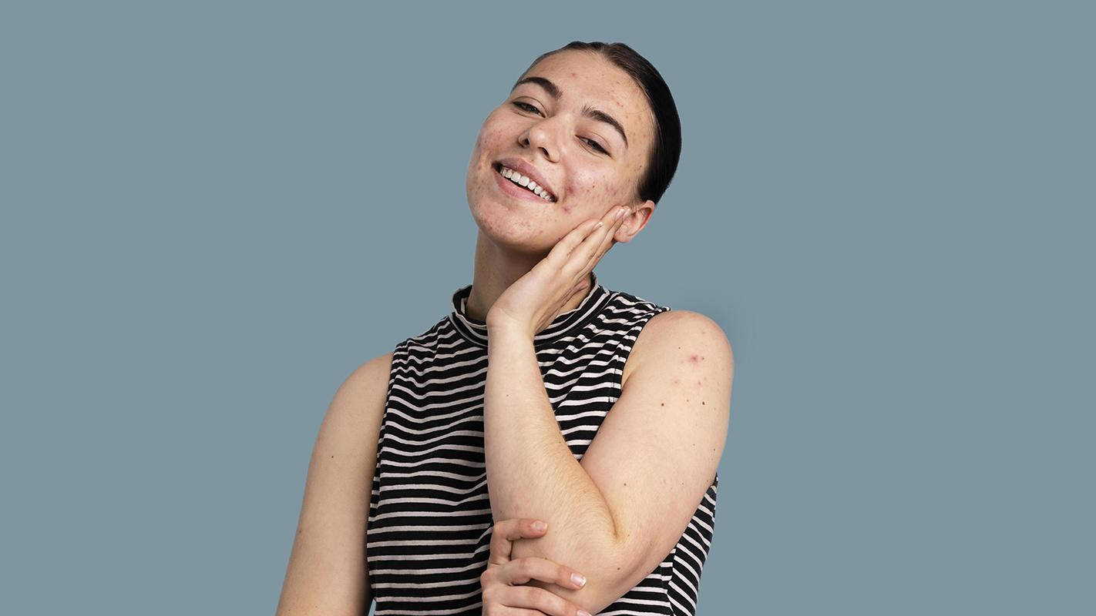
THANK YOU!

